Slide 1

Searching for Minds, Metaphysically:
Introduction to Philosophy of Consciousness
HSSP 2020 class H14068
Week 1: 07.11.2020

Slide 2
Today’s Agenda
Introductions
Course overview and objectives
What is consciousness?
(Am I conscious?)
Next class preview
Extra materials

Slide 3
Introductions!
Tell us…
Your name
Your pronouns
Where are you calling in from?
What made you sign up for this class?
About your hat, if you want to!
… and pass it onto someone else.

Slide 4
Why do we care?
Personal curiosities and interest
Everyday interactions
Policies and legal bindings
Moral responsibility

Slide 5

Why do we care?
What things are conscious and what things aren’t conscious? What is the reasoning behind the distinction? What is our criteria to attribute consciousness to something?
→ requires understanding of what consciousness is, and what is needed for it.

Slide 6
Course overview & objectives
Our main question is: what makes something conscious?
1. What is consciousness? Am I conscious?
2. Is (my human friend) Amy conscious?
3. Is (my dog) Fido conscious?
4. Is (the robot) Sophia conscious?
5. Is (my digital clone) ME 2.0 conscious?
Notes:
Because we want to model to hold when evaluating all sorts of things.

Slide 7
Consciousness!

Slide 8
But first.. the mind
The first prerequisite for the existence of consciousness in a being: the existence of a mind!
Notes:
So we must unpack that idea—mind--first.

Slide 9
Where is the mind?
→ what does it mean for the mind to be unified (somehow) with the body?
Notes:
annotate

Slide 10
Mind and Body
Group discussion:
What are some properties or characteristics of the mind?
What are some properties or characteristics of the body?
What are some activities you do with each of them?
What are some examples of the mind and body interacting/influencing one another?
Notes:
https://padlet.com/youngzielee/rvtsryz8hgn1cv2m

Slide 11
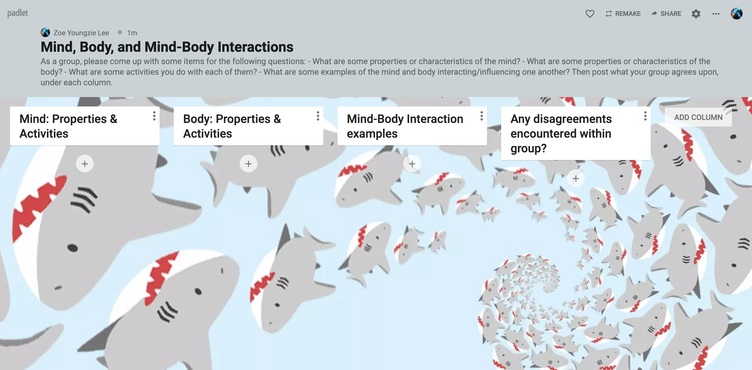
Notes:
Substance vs. property dualism
Dualist views say that the mental and the physical are both real and neither can be assimilated to the other. For the various forms that dualism can take and the associated problems, see below.

Slide 12
The mind-body problem
What is the relationship between the mind and body?
How are they tied to each other?
How do they interact?

Slide 13
The mind-body problem
What is the relationship between the mind and body?
Is one a subclass of the other? Or completely distinct?
Can the mind cause changes in the body?
Can the body cause changes in the mind?
Notes:
Think about these questions if you have free time!
Same padlet: https://padlet.com/youngzielee/rvtsryz8hgn1cv2m

Slide 14
Week 2 Preview
What’s the problem with the mind-body problem?
Consciousness is an even more perplexing problem!
Am I conscious? How do we convince someone else that we are conscious?
What convinces us that someone else is conscious?

Slide 15
Extra readings & materials
Tim Crane’s Introduction to Mind-Body Problem
  (if you want to do some advance reading)
Jaegwon Kim – Philosophy of Mind
  (if you want a textbook-like introduction to Philosophy of Mind)
Stanford Encyclopedia of Philosophy (https://plato.stanford.edu/)
  Dense and comprehensive Philosophy Wikipedia! (Challenging, but good reference for Philosophy.)

Slide 16
Any questions?

